Slide 1
Unit 11
How was your school trip?
Section B 3a-Self Check
七年级下册

Slide 2

Let's stuy together

Slide 3
Which activities did I do?
have delicious food
met
meet friendly
people
had
got
get sb’s autograph
亲笔签名
climb the mountain
saw
see interesting
movies
climbed
activities
go shopping
took
take
photos
went
played
eat ice cream
play beach
volleyball
ate
bought
win a
prize
buy a souvenir
hang out
won
奖品
纪念品
hung

Slide 4
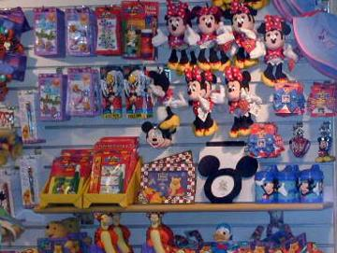
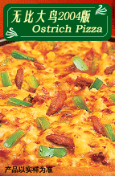
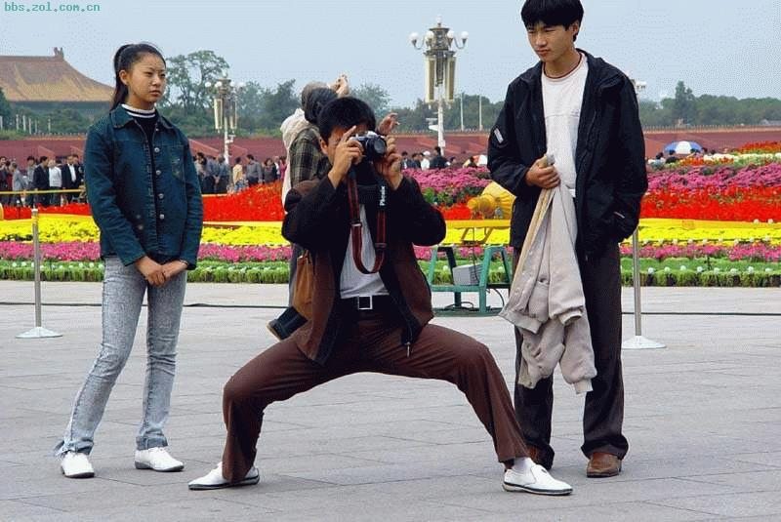
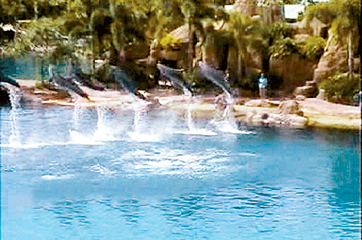
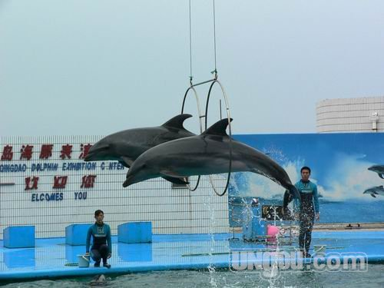

Did you +V. …?
Yes, I did. I V.-ed …
(No, I didn’t.. I didn’t +V. …
buy (bought)
a gift
have ( had)
a pizza
take( took)
photos
go (went) to
outdoor pool
watch (watched)
a dolphin show
watch (watched)
a movie about
sharks

Slide 5
Past过去
Present现在
rode a horse
fed chickens
did homework
went to a countryside
picked strawberries
milked a cow
ride a horse
feed chickens
do homework
go to a countryside
pick strawberries
milk a cow

Slide 6

Objectives
To give students writing practice with the target language.
To let students review the key vocabulary and functions presented in the unit.

Slide 7
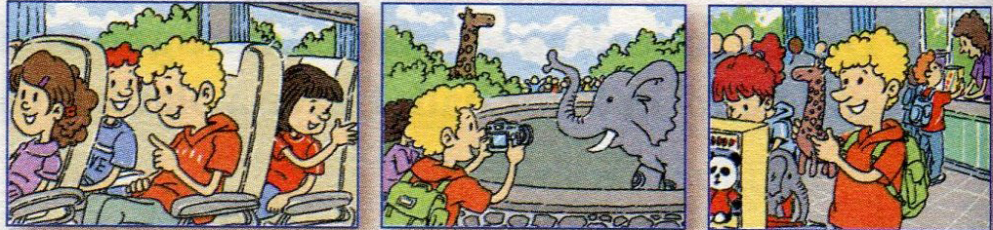
3a. Look at the pictures of Bob’s
school trip. Complete his diary
entry.

Slide 8
June 23rd
Yesterday my school visited the zoo. It was
really__________. We went there by bus. At
the zoo, I saw a lot of___________ and I took
some photos. My classmates and I also went
to the__________ and bought some_________.
It was a great day.
interesting
animals
gift shop
gifts

Slide 9
3b. Linda is Bob’s classmate.
Complete her diary entry.
June 23rd
My school went to the zoo yesterday. The trip was
______. At the zoo, I _________________but I
didn’t like them. I also went to ____________with
my classmates, but I didn’t buy anything
because __________________. It was a boring day.
boring
saw many animals
the gift shop
they are so expensive

Slide 10
3c. Now write a diary entry for
your own school trip. Explain
if you liked it or didn’t like it
and why.

Slide 11
Example:
Diary
Yesterday we went on a school trip to a bicycle
museum. My friend Bill liked it a lot. He really
liked looking at the old bikes. But I did not enjoy
the museum very much. I am not really interested
in bicycles. I like computers more. Also, there were
too many people at the museum, and they were very
noisy. The museum restaurant was expensive, too.
I hope we can go to a computer museum next year.
______________________________________
______________________________________
______________________________________
______________________________________
______________________________________
______________________________________
______________________________________
______________________________________

Slide 12
Self Check
1 Write more verbs and their past forms
in each group.
climb-climbed | arrive-arrived | study-studied
pick-picked
milk-milked
play-played
stay-stayed
want-wanted
hope-hoped
live-lived
move-moved
dance-danced
worry-worried
cry-cried

Slide 13
stop-stopped | get-got
have-had
eat-ate
do-did
go-went
see-saw
ride-rode
plan-planned
prefer-preferred
fit-fitted

Slide 14
2. Complete the conversations with
the correct forms of the verbs in the
box .
have do swim go
be see feed

Slide 15
have do swim go
be see feed
1. A: I went to the countryside this
summer.
B: Really? How_____ the trip?
A: It_____ great!
B: What _____ you_____
there?
A: I _____the chickens
and _______ in a river.
was
was
did
do
fed
swam

Slide 16
have do swim go
be see feed
2. A:_____ you_____ a nice weekend?
B: Yes, I did.
A: ____ you ____ anywhere?
B: Yes, I _____ to the mountains.
The air_____ so clean and
I ____ a lot of flowers.
Did
have
Did
go
went
was
saw

Slide 17
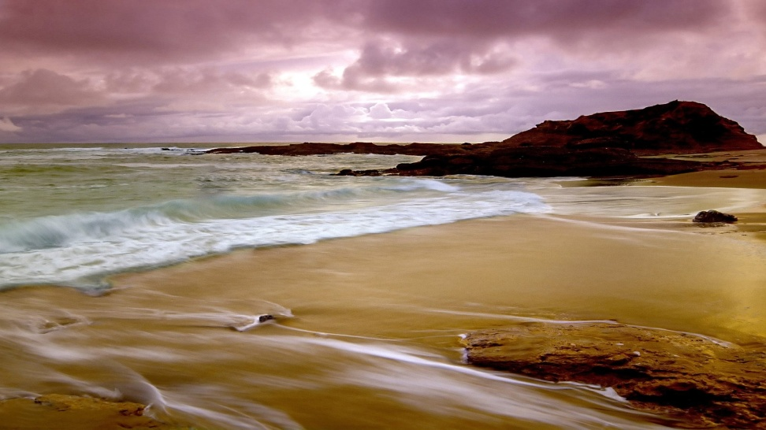
1. beach, I , last week, my parents
Exercises
Ⅰ. Make sentences
I went to the beach with my parents last week.

Slide 18

2. drink cafe, just now, my aunt in a cafeteria
My aunt drank coffee in a
cafeteria just now.

Slide 19
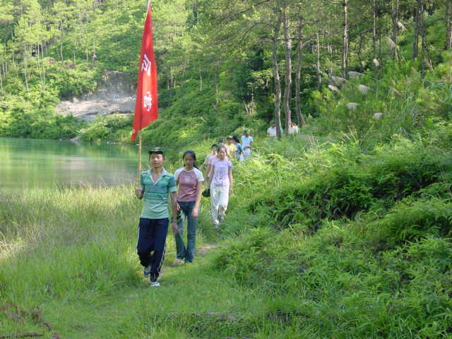
3. summer camp, last summer we, take part in
We took part in the summer
camp last summer.

Slide 20
1. Maria _____first prize in yesterday’s singing competition.
2. we _____ a famous basketball player.
3. I ______ a bowl of noodles for lunch.
They were terrible.
4. I helped sally ____ a new watch.
5. We _______ a movie about living in the future.
Ⅱ.从buy, win, watch, meet, have中选择正确的单词填空。
won
met
had
buy
watched

Slide 21
A: How ___ your school trip? ____ you have a good time?
B: I _____ a very fun day over the weekend. First I ______the
Visitor’s Center. Then we _______ many souvenirs at the gift shop.
After that we ______ to the zoo.
We were very happy.
Ⅲ. 从do, visit, have, go, buy, be中选择
正确的单词填空。
was
Did
had
visited
bought
went

Slide 22
Ⅳ. 句型转换
1. Lucy did her homework at home.
(改否定句)
Lucy _______ _____ her homework
at home.
2. His father worked all day last
Monday.（改一般疑问句）
______ his father _______ all day
last Monday?
didn’t
do
Did
work

Slide 23
I was very busy last week.
(改为一般疑问句)
_____ you very busy last week?
4. There was some orange in the cup.
(变一般疑问句)
_____ there _____ orange in the cup?
Were
Was
any

Slide 24
5. We saw some seals at the Blue Water
Aquarium. (就划线部分提问)
_________ you ____ at the Blue Water
Aquarium?
6. Ben’s friends enjoyed themselves on
the school trip. (改为同义句)
Ben’s friends ____ a great ____ on the
school trip.
What did
see
had
time

Slide 25
1. Bill ______(help) his mother clean the room yesterday.
2. On my last day off, I _____(sleep) late.
3. They ______(have) a school trip last
Sunday. They ______ (visit) the
Mount Xiang Shan and _____(meet) a lot of foreigners.
Ⅴ. 用所给单词的适当形式填空
helped
slept
had
visited
met

Slide 26
4. -- _____ (be) there some water in the
glass? I want to drink some.
--No, there _______(not be). Please
buy some.
5. ______ Li Ming ________ (study)
English this morning？
Were
weren’t
Did
study

Slide 27
Ⅵ. 根据提示完成下列句子
Did you buy a g___ (a thing that you give to sb., especially on a special occasion) for your sister?
2. Are there many v______ (persons who visit some places) in your city?
ift
isitors

Slide 28
gain
3. Please say it a____ (one more time).
4. She’s going to have her birthday party at the e___ (the final part of a period of time)
of the week.
nd

Slide 29
Homework
Imagine you went on vacation to some
place. Write to a friend about your trip.
Where did you go?
Were you with your family?
What did you do?
How was the weather?
Was the food good?
Did you buy anything?
Do you want to go again?

Slide 30
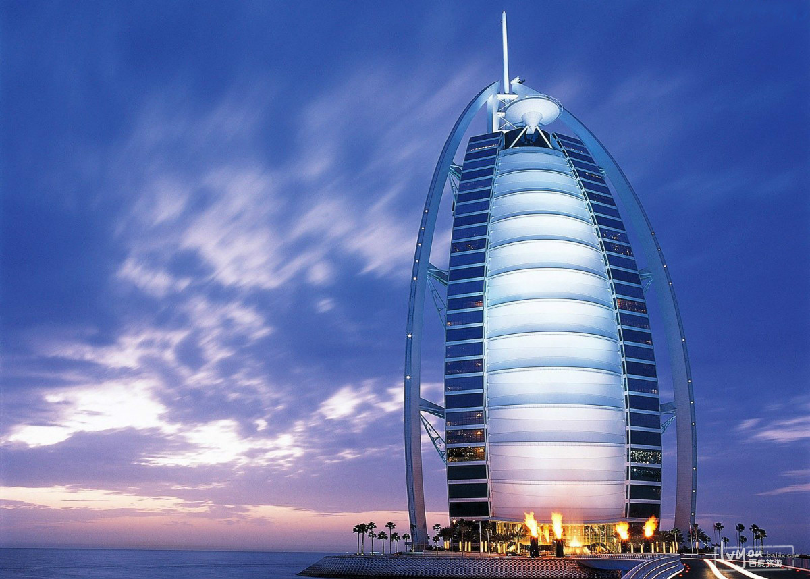
迪拜

Slide 31
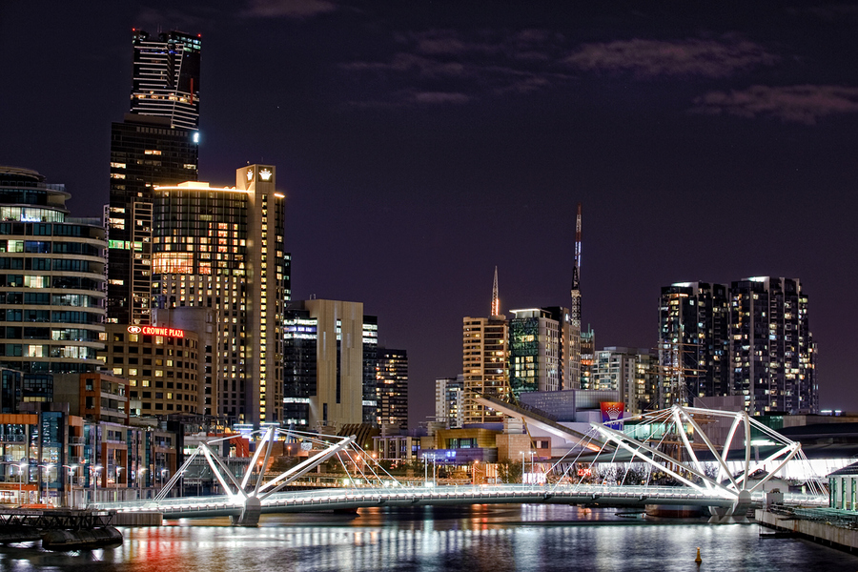
墨尔本

Slide 32
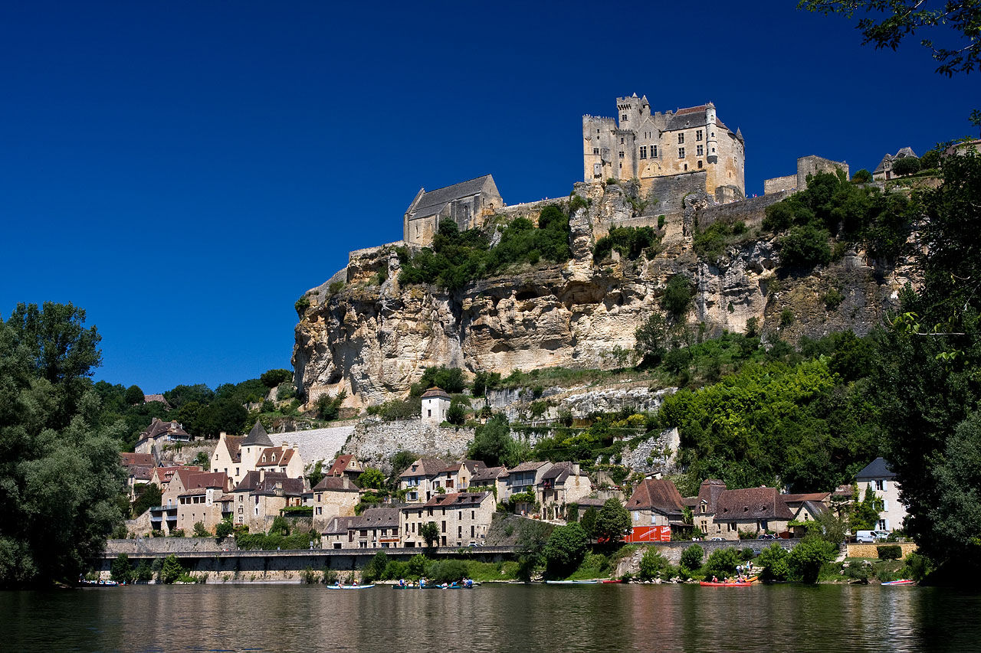
摩纳哥

Slide 33
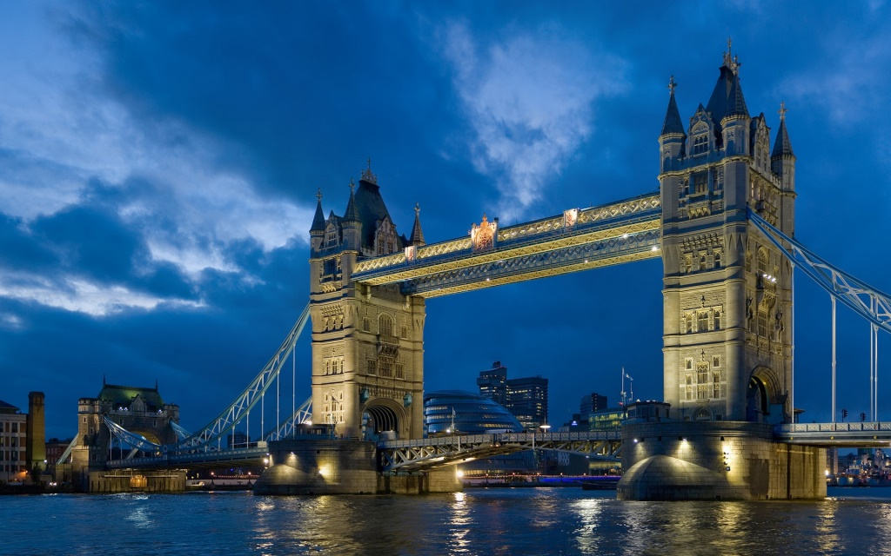
伦敦

Slide 34
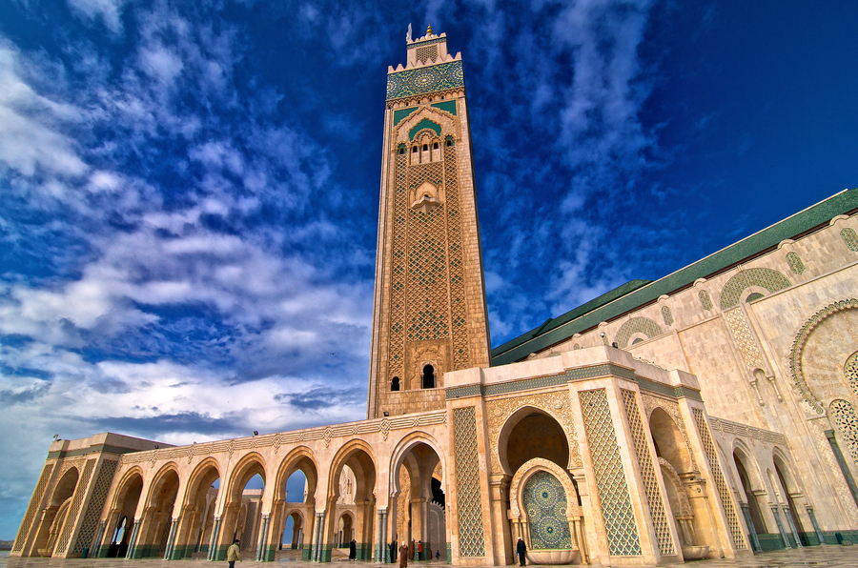
卡萨布兰卡

Slide 35
Thank You!

